Slide 1
Develop an AI agent with Azure AI Foundry Agent Service
Module-2

Slide 2
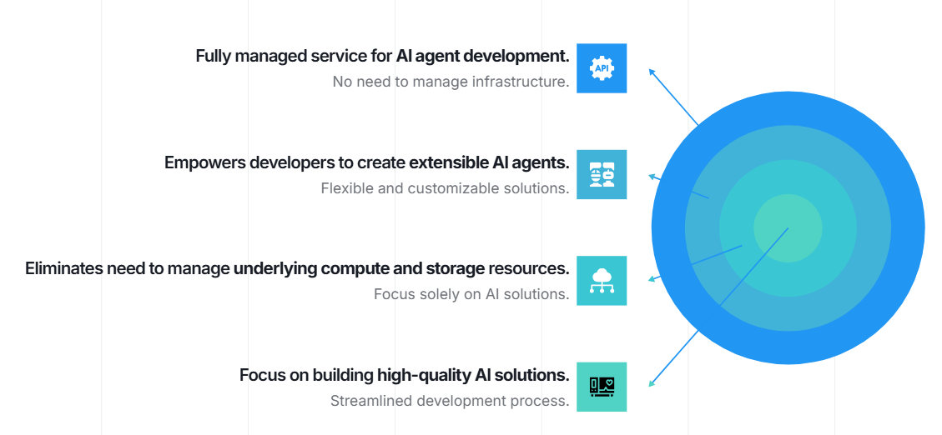
Introduction

Slide 3
How to use Azure AI Foundry Agent Service
Answer questions using real-time or proprietary data sources.
Make decisions and perform actions based on user inputs.
Automate complex workflows by combining generative AI models with tools that interact with real-world data.
For example, an AI agent can be created to generate reports, analyze data, or even interact with users through apps or chatbots, making it suitable for customer support, data analysis, and automated reporting.

Slide 4
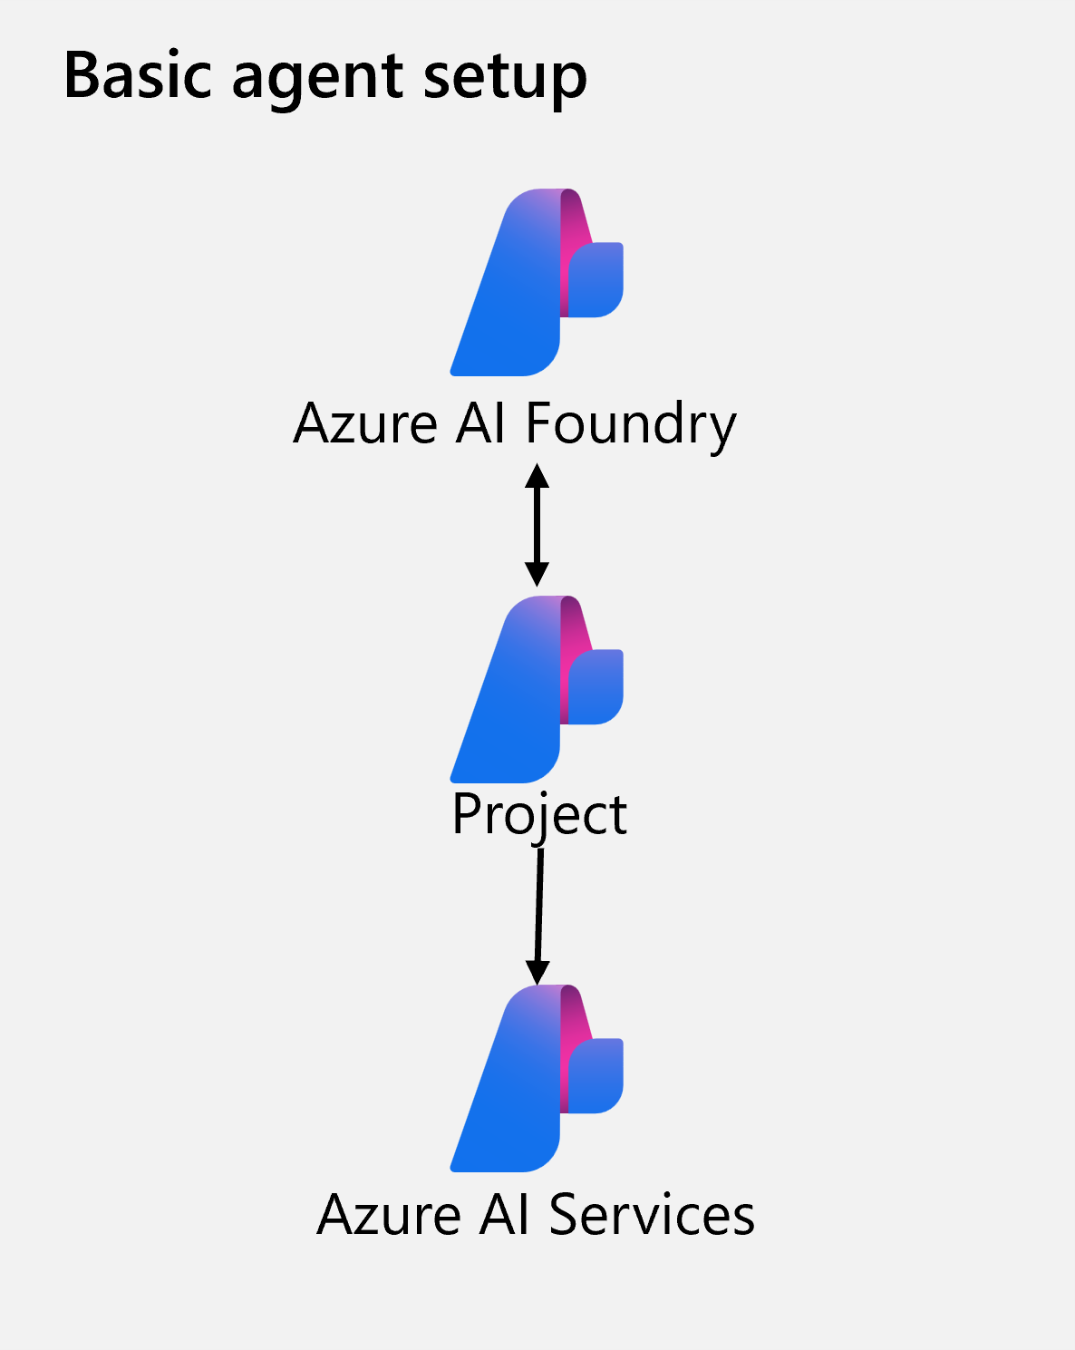
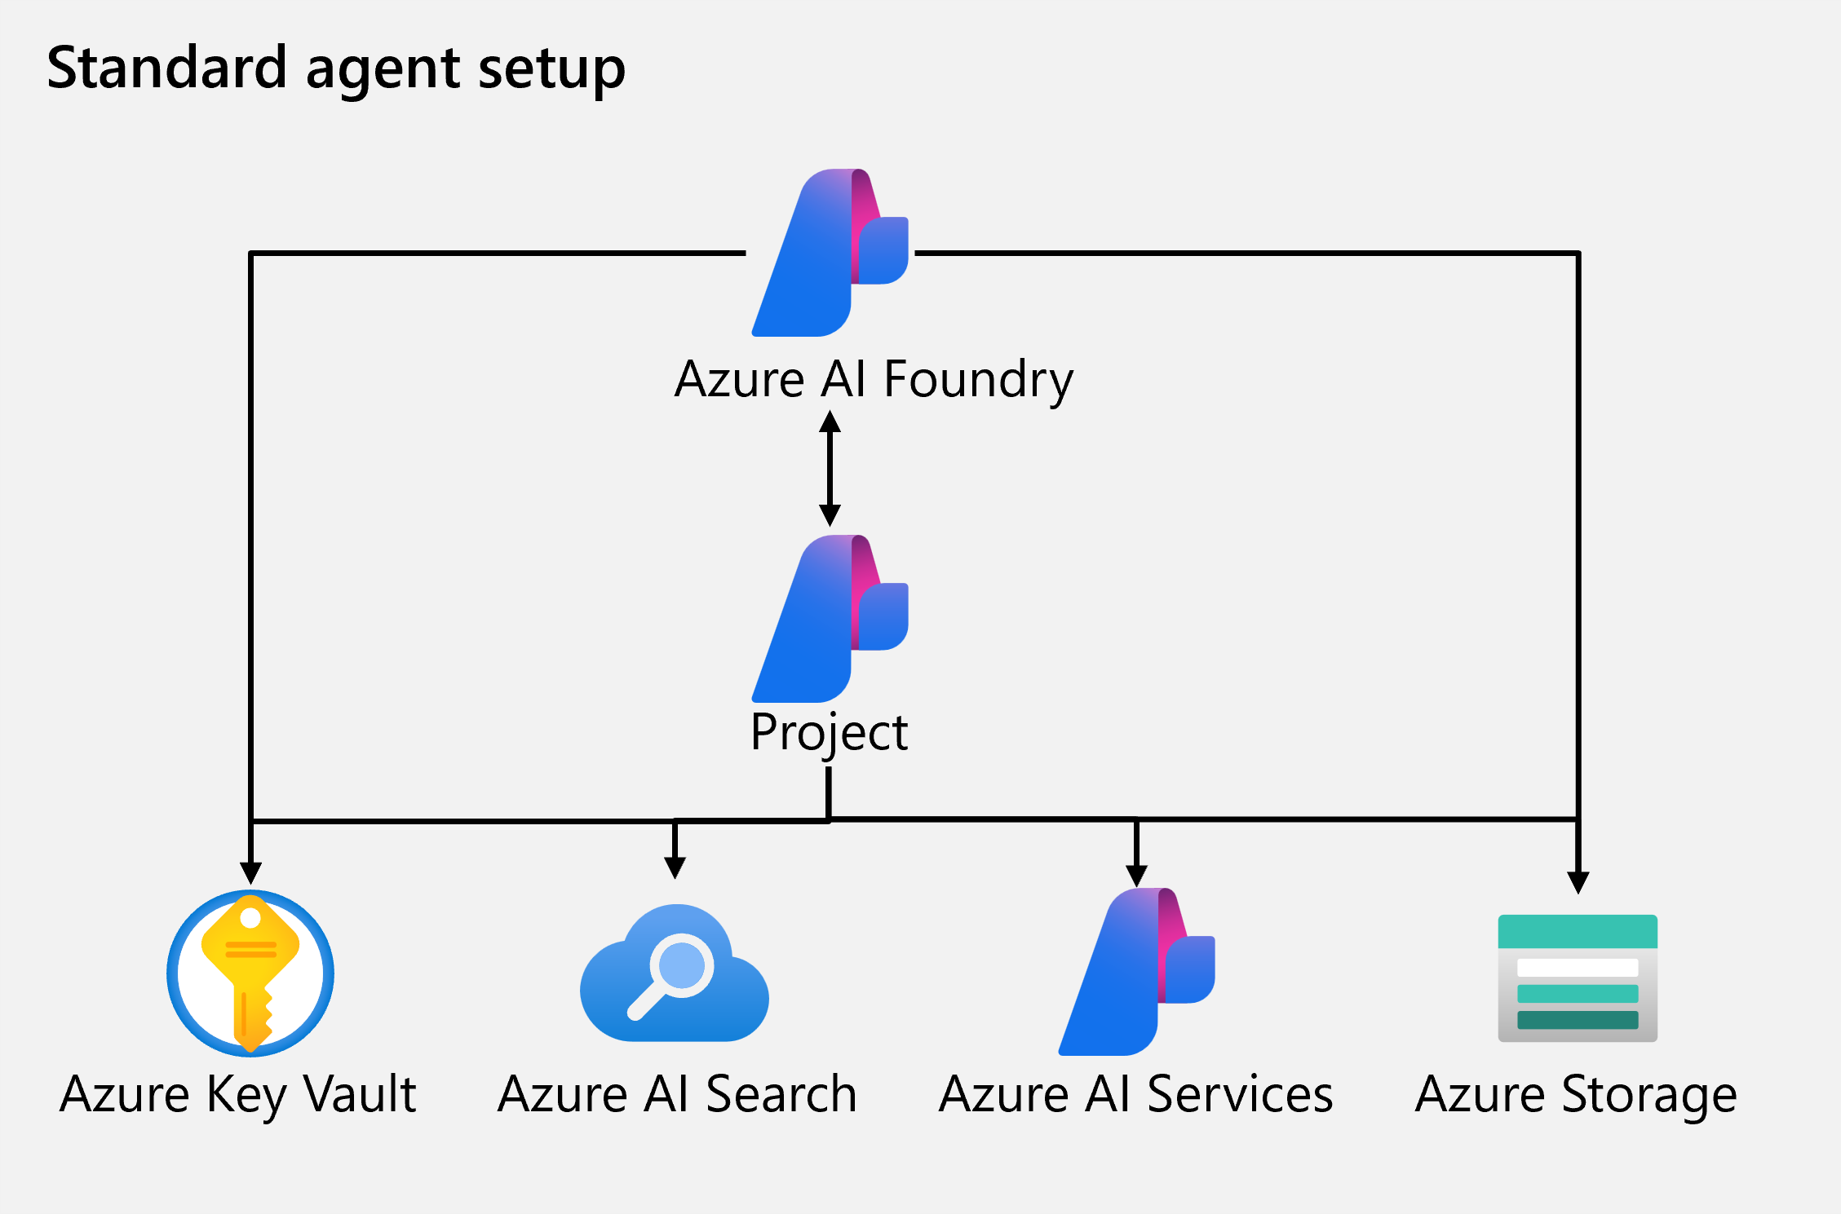

Slide 5
Use Case: Analyze data and Create Charts
Category | Cost
Accommodation | 674.56
Transportation | 2301.00
Meals | 267.89
Misc. | 34.50

Slide 6
Module-3: Integrate custom tools into your agent
Learning objectives
Describe the benefits of using custom tools with your agent.
Explore the different options for custom tools.
Build an agent that integrates custom tools using the Azure AI Foundry Agent Service.

Slide 7
Introduction
Empower non-ML experts to build powerful AI agents
  using Azure AI Foundry Agent Service’s no-code/low-code capabilities and built-in tools.
Extend agent functionality with custom tools
  integrate your own code, APIs, or services to handle complex, real-world tasks beyond the model's native abilities.
Boost efficiency and customer satisfaction
  by deploying purpose-built agents (e.g., retail FAQ bots) that automate repetitive tasks and free up
  human resources.

Slide 8
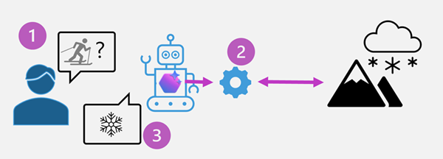
Why use custom tools?
Enhanced productivity: Automate repetitive tasks and streamline workflows.
Improved accuracy: Provide precise and consistent outputs, reducing human error.
Tailored solutions: Address specific business needs and optimize processes.

Slide 9
Common scenarios for custom tools in agents
Customer support automation
Scenario: A retail company integrates a custom tool that connects the Azure AI Agent to their customer relationship management (CRM) system.
Functionality: The AI agent can retrieve customer order histories, process refunds, and provide real-time updates on shipping statuses.
Outcome: Faster resolution of customer queries, reduced workload for support teams, and improved customer satisfaction.

Slide 10
Inventory management
Scenario: A manufacturing company develops a custom tool to link the AI agent with their inventory management system.
Functionality: The AI agent can check stock levels, predict restocking needs using historical data, and place orders with suppliers automatically.
Outcome: Streamlined inventory processes and optimized supply chain operations.

Slide 11
Healthcare appointment scheduling
Scenario: A healthcare provider integrates a custom scheduling tool with the AI agent.
Functionality: The AI agent can access patient records, suggest available appointment slots, and send reminders to patients.
Outcome: Reduced administrative burden, improved patient experience, and better resource utilization.

Slide 12
IT Helpdesk support
Scenario: An IT department develops a custom tool to integrate the AI agent with their ticketing and knowledge base systems.
Functionality: The AI agent can troubleshoot common technical issues, escalate complex problems, and track ticket statuses.
Outcome: Faster issue resolution, reduced downtime, and improved employee productivity.

Slide 13
Options for implementing custom tools
Custom Function Calling
– Define & invoke structured functions dynamically
– Enables custom logic/workflows across languages
Azure Functions
– Event-driven, serverless code with triggers & bindings
– Scales easily for real-time agent interactions
OpenAPI Tools
– Connect agents to external APIs via OpenAPI 3.0
– Automates API integration, client code, and testing
Azure Logic Apps
– Low-code workflows for connecting services & data
– Ideal for business automation and orchestration

Slide 14
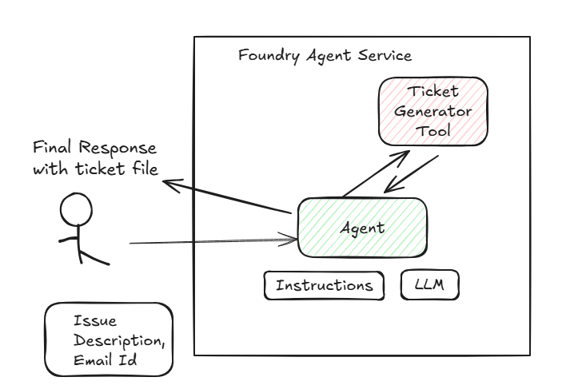
Exercise - Build an agent with custom tools

Slide 15
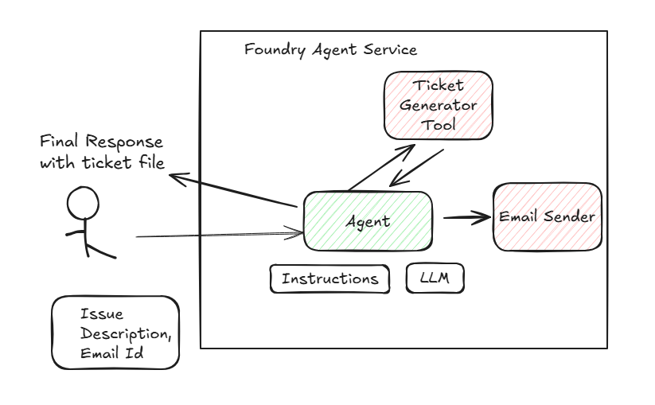
Exercise - Build an agent with custom tools

Slide 16
Module-4: Develop a multi-agent solution with Foundry Agent Service
Describe how connected agents enable modular, collaborative workflows.
Design a multi-agent solution by defining main agent tools and connected agent roles.
Build and run a connected agent solution

Slide 17
Building Smart Multi-Agent Systems with Azure AI Foundry
Split tasks using connected agents
No need for custom routing/orchestration
Boost efficiency and scalability
Example:(bugs, features, infra issues)

Slide 18
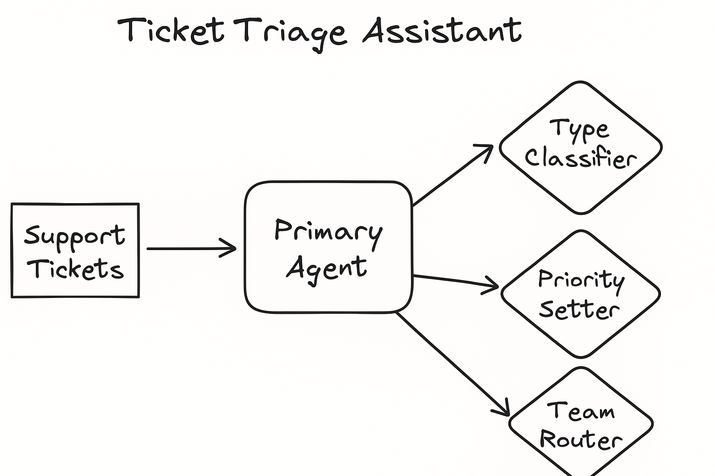
Example:(bugs, features, infra issues)

Slide 19
Why use connected agents?
Build modular solutions
Specialized capabilities per agent
Scaling
Improved reliability and traceability
Flexible and extensible

Slide 20
Design a multi-agent solution with connected agents

Slide 21
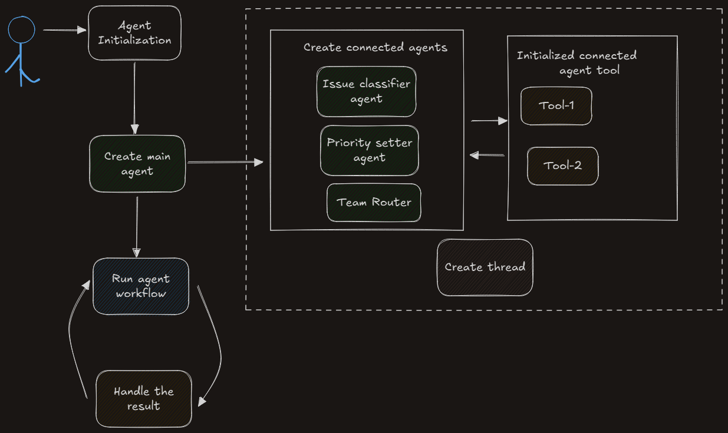
Design a multi-agent solution with connected agents

Slide 22
Module-5: Integrate MCP Tools with Azure AI Agents
Explain the roles of the MCP server and client in tool discovery and invocation.
Wrap MCP tools as asynchronous functions and register them with Azure AI agents.
Build an Azure AI agent that dynamically accesses and calls MCP tools during runtime.

Slide 23
Why use dynamic tool discovery with MCP?
Scalability: Easily add new tools or update existing ones without redeploying agents.
Modularity: Agents can remain simple, focusing on delegation rather than managing tool details.
Maintainability: Centralized tool management reduces duplication and errors.
Flexibility: Supports diverse tool types and complex workflows by aggregating capabilities.

Slide 24
Register tools with an Azure AI Agent
Tool definitions decorated with @mcp.tool.
The MCP client initializes an MCP client connection to the server.
session.list_tools().
session.call_tool
FunctionTool that makes them usable by the agent.

Slide 25
Module-6: Develop an AI agent with Semantic Kernel
By the end of this module, you'll be able to:
  Use Semantic Kernel to connect to an Azure AI Foundry project
  Create Azure AI Foundry Agent Service agents using the Semantic Kernel SDK
  Integrate plugin functions with your AI agent

Slide 26
Introduction
💡 What is Semantic Kernel?
Semantic Kernel is an open-source SDK by Microsoft that enables developers to build AI agents powered by LLMs. It acts as a bridge between AI models and your application logic, making it easy to:
Integrate LLMs (OpenAI, Azure OpenAI)
Combine AI with traditional code and external APIs
Compose functions and skills to execute real-world tasks

Slide 27
⚙️ Core Components
  Kernel: Central orchestrator that manages prompts, functions, and plugins
  Plugins: Collections of semantic or native functions (e.g., file I/O, API calls)
  Functions: Modular units of logic (semantic prompts or native code)
  Planners: Enable task decomposition and sequencing for complex goals
  Connectors: Integration with external systems (e.g., calendars, emails, databases)

Slide 28
🧩 Agent Framework in Semantic Kernel
  ChatCompletionAgent – LLM-backed chat-style agent
  AzureAIAgent – Built for Azure AI Foundry Agent Service
  OpenAIAssistantAgent – Compatible with OpenAI Assistants API
  GroupChat – For multi-agent collaboration and orchestration

Slide 29
🛠️ Developer Capabilities
  Rapid prototyping of agents with minimal code
  Add natural language reasoning into apps
  Call custom or built-in plugins from your agents
  Easily switch between Azure and OpenAI backends
  Support for memory, token limits, tool selection, and more

Slide 30
Semantic Kernel core components
The Semantic Kernel offers different components that can be used individually or combined.
AI service connectors - connect the code to AI services from different providers under a common interface. Supported services include Chat Completion, Text Generation, and more.
Memory connectors - expose vector stores from other providers under a common interface.
Functions and plugins - containers for functions that are registered with the kernel. Once registered, functions can be invoked by the AI or through prompt templates.
Prompt templates - combine instructions, user input, and function outputs into a reusable format. Prompt templates allow AI models to execute predefined steps dynamically.
Filters - allow custom actions to be performed before and after a function or prompt is invoked. When registered, function filters act as outer layers and prompt filters as inner layers.

Slide 31
Module 7: Orchestrate a multi-agent solution using Semantic Kernel
Build AI agents using the Semantic Kernel SDK
Develop multi-agent solutions
Create custom selection and termination strategies for agent collaboration

Slide 32
Why Multiagent?
Simple Task
Single Agent
Complex Task
Multiple Agents

Slide 33
Monitoring
Scalable
Root Cause Analysis
Intelligent
DevOps Bug
Reduce Manual
Automated Deployment
Improve Efficiency
Reporting Summary
Streamline DevOps Process

Slide 34
Semantic Kernel Agent Framework & Core Components
Robust
Intelligent
Autonomous
Collaborative Agents
Agents
Agent Collaboration
Kernel
Tools and Plugins
History

Slide 35
Types of agents
Azure AI Agent
Chat Completion Agen
OpenAI Assistant Agent
Seamless tool integration
Automatic tool calling
History management using threads
Built in tools: code execution, file retrieval, data interaction using bing, Azure AI search, Azure Functions
Designed for Chat completion and conversation interfaces
Supports NLP
Contextual Understanding
Dialogue Management
More advanced capabilities
Multistep tasks
Supports agent goal driven interactions
Code interpretation
File search

Slide 36
Design an agent selection strategy
Why is agent selection important?
Accuracy: Routes queries to the most relevant agent, ensuring precise and contextually appropriate responses.
Efficiency: Reduces processing time by leveraging the expertise of specialized agents.
Scalability: Enables the system to handle diverse and growing query volumes without overwhelming individual agents, delivering optimal responses even as the number of agents increases.

Slide 37
How does the framework select agents?
Single-turn conversations
Intent recognition: Matches user query with the most relevant agent.
Predefined rules: Uses developer-defined routing logic.
Multi-turn conversations
Context tracking: Maintains conversation history to infer intent.
Dynamic switching: Switches agents as topics shift mid-conversation.

Slide 38
Agent selection strategy
Selection Strategy: Determines which agent responds in multi-turn conversations.
Defined via predefined classes or custom logic using SelectionStrategy.
Predefined Strategies:
  SequentialSelectionStrategy: Agents take turns based on the order they were added. You can set an initial agent.
  KernelFunctionSelectionStrategy: Uses a prompt-based function to decide agent turns dynamically based on conversation history.
Custom Strategy:
  Extend SelectionStrategy and override select_agent() to implement custom logic.
Usage:
  Assign your strategy to the selection_strategy parameter when creating the AgentGroupChat object.

Slide 39
Chat Termination Strategy
Purpose: Ends multi-turn conversations gracefully to save resources and improve UX.
Why use it?
  Efficiency: Avoids infinite loops and reduces computation.
  User satisfaction: Prevents overly long or repetitive chats.
  Goal completion: Ends chat once the task is achieved.

Slide 40
Types of Termination Strategies
Kernel Function Termination Strategy
Default Termination
Strategy
Custom Strategy
Ends chat after a set
number of iterations
(default: 99)
Uses a prompt + result_parser function to decide when to stop
  Extend TerminationStrategy and override should_agent_terminate() to define custom logic.

Slide 41
DevOps Bug Fix Project
Service Name
Resource Name
Incident Manager
DevOps Bug Log Files
Restart
Rollback the Transaction
DevOps Assistant
Redeploy
Increase quota
Function Response
Escalates

Slide 42
Thank You!!

